Slide 1
HEVC in JEG-Hybrid
glenn.vanwallendael@ugent.be
nicolas.staelens@intec.ugent.be

Slide 2
SRC selection
10 SRC similar to the AVC experiment within JEG-Hybrid

Slide 3
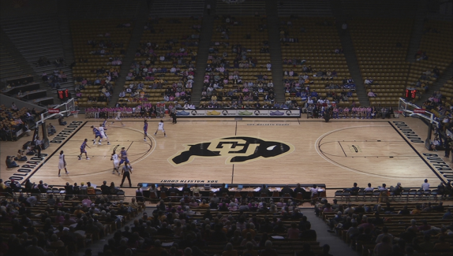
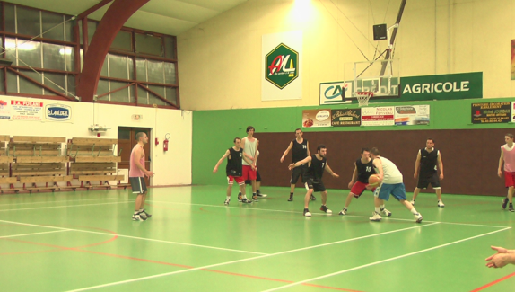
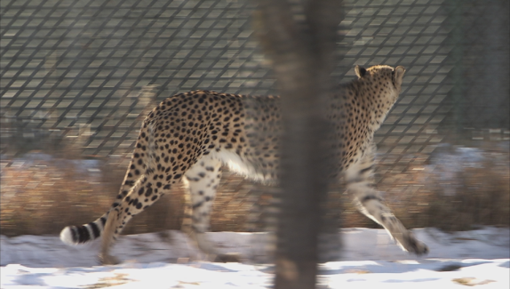
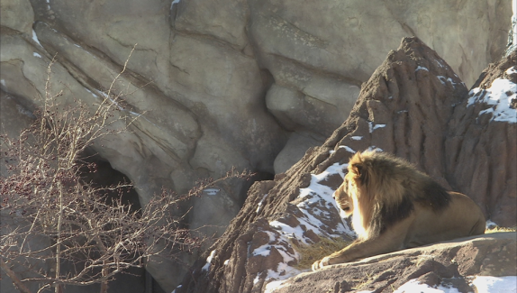
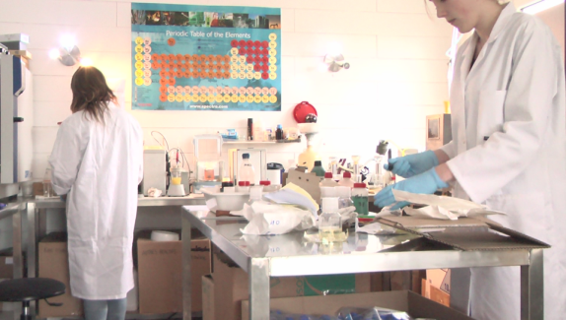
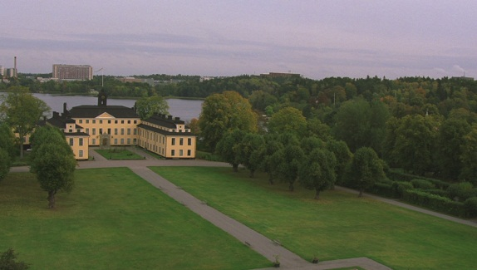
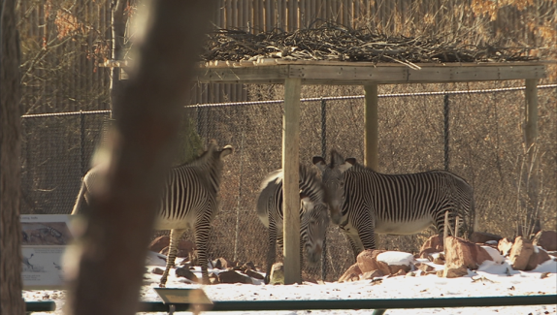
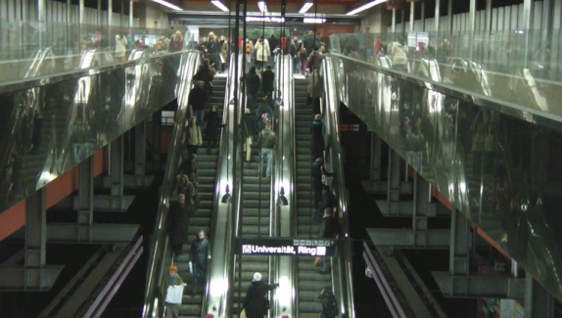

Slide 4
HRC
Encoding only
HEVC: HM11.1
Bitrate | 500kbps, 1Mbps, 2Mbps, 4Mbps, 8Mbps, 16Mbps
Rate control | Picture adaptive, CU adaptive
QP | 26, 32, 38, 46
GOP | 1, 2, 4, 8
Intra period | 8, 16, 32, 64
Random access | IDR (closed-GOP intra), CDR (open-GOP intra)
Resolution | 1920x1080, 1280x720, 960x544
Slices | 0, 2, 4, 1500byte

Slide 5
GOP structures
1:
2:
4:
8:
I
B
B
B
B
I
B
B
B
B
I
B
B
B
B
I
B
B
B
B
B
B
B
B

Slide 6
PVS generation status
60360 HEVC sequences generated
Corresponds to 292 GB of sequences

Slide 7
Full-reference metric calculation
In progress:
Peak Signal-to-Noise Ratio (PSNR)
Structural Similarity Index (SSIM)
Video Quality Metric (VQM)
Visual Information Fidelity (VIF)
Help needed for:
SwissQual’s Metric
Tetra Video Quality Metric (TetraVQM)
MOtion-based Video Integrity Evaluation (MOVIE)

Slide 8
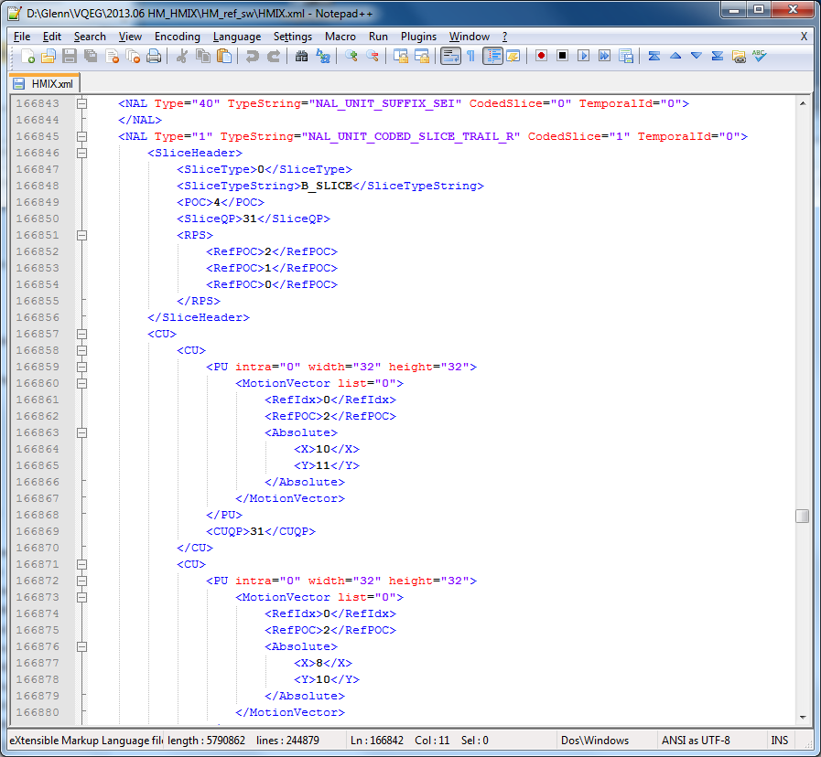
HMIX generation
Convert bitstream information in XML format
HM 11.1 modified to generate HMIX file
Small differences with JM HMIX
Needs further improvement

Slide 9
HMIX generation
NAL type
SliceHeader
SliceType
POC
SliceQP
RPS: RefPOC
CU
CUQP
PU
MV
RefPOC
IntraDir

Slide 10
No-reference indicators
Blockiness
Blurriness
Exposure
Noisiness
Flickering
Spatial Activity (Intensity)
Temporal Activity (Intensity)
Spatial Correlation
Energy
Homogeneity
Variance
Contrast
Colour Layout Descriptor
Edge Histogram Descriptor

Slide 11
Future work
Further encode HEVC PVS
Further calculate full-reference metrics on PVS as ground truth
Start with calculating no-reference indicators on PVS
Create a common AVC-HEVC model based on previously calculated metrics and HMIX information

